Slide 1


TSX-V: VO
OTCQB: KVLQF
FSE: KEQ0
BUILDING A
BRAZILIAN PRECIOUS METALS POWERHOUSE
PROUD MEMBER OF
Feb 2026

Slide 2
Forward-Looking Statements
This presentation contains "forward-looking statements". These forward-looking statements are made as of the date of this presentation and ValOre Metals Corp. does not intend, and does not assume any obligation, to update these forward-looking statements. Forward-looking statements include, but are not limited to, statements with respect to the timing and amount of estimated future exploration, success of exploration activities, expenditures, permitting, and requirements for additional capital and access to data.
Forward-looking statements involve known and unknown risks, uncertainties and other factors which may cause the actual results, performance or achievements of the Company to be materially different from any future results, performance or achievements expressed or implied by the forward-looking statements. Such factors include, among others, risks related to actual results of current exploration activities; changes in project parameters as plans continue to be refined; the ability to enter into joint ventures or to acquire or dispose of property interests; future prices of mineral resources; accidents, labor disputes and other risks of the mining industry; ability to obtain financing; and delays in obtaining governmental approvals or financing.
This presentation does not constitute an offer to sell or solicitation of an offer to buy any securities of ValOre Metals Corp.
Fábio Valério (P.Geo.) and Porfirio Cabaleiro (P.Eng.), of GE21 are the Qualified Person, as defined in NI 43-101, responsible for the Pedra Branca mineral resource estimates as reported herein. *The 2022 Technical Report is entitled “Independent Technical Report –Mineral Resource Update on the Pedra Branca PGE Project, Ceará State, Brazil” and was prepared by Independent qualified persons, Fábio Valério (P.Geo.) and Porfirio Cabaleiro (P.Eng.), of GE21, commissioned to complete the mineral resource estimate, and Chris Kaye of Mine and Quarry Engineering Services Inc. (MQes), commissioned to review the metallurgical information. The report was prepared as a National Instrument 43-101 Technical Report on behalf of ValOre Metals Corp. with an effective date of March 08, 2022.
The technical information in this presentation has been prepared in accordance with Canadian regulatory requirements set out in NI 43-101 and reviewed and approved by Thiago Diniz, P.Geo., ValOre’s QP and Vice President of Exploration.

Slide 3

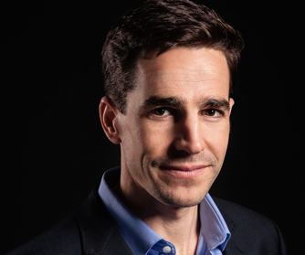





MINING IN OUR DNA
FROM DISCOVERY TO PRODUCTION
5 Major Discoveries
$300M Raised
CAD$1.7B in M&A
Driven by ValOre Directors
Acquired by
Rio Tinto:
$650M
Acquired by
Coeur Mining:
$117M
Acquired by
Royal Gold:
$200M
Jim Paterson | Chairman
Nick Smart | CEO
Co-founder and principal of Discovery Group
27 years Executive Leadership experience;
Director/officer of companies which have
                raised $300+M in equity, and
        participated in $1+B in M&A transactions
        delivered exploration discoveries at multiple projects globally
21 years experience at Anglo American & De Beers.
Chemical Engineer
Globally experienced leader in mining & minerals processing
Design, construction and operation of large scale mining projects:
Platinum & Zinc in South Africa,
Nickel in Brazil,
Diamonds in Canada and,
Corporate roles in UK and startup ventures
Acquired by
Goldcorp:
$520M
2008 IPO; 2010 Created
USA Met Coal Producer
Valued $250M
3

Slide 4
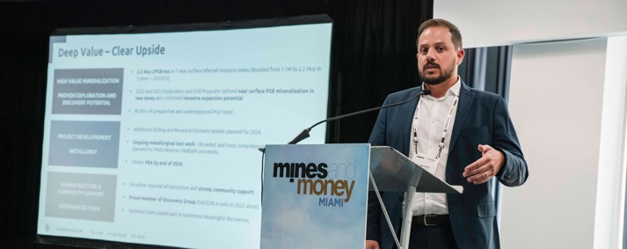
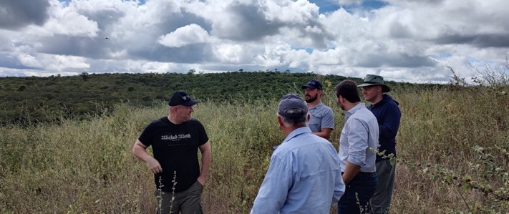

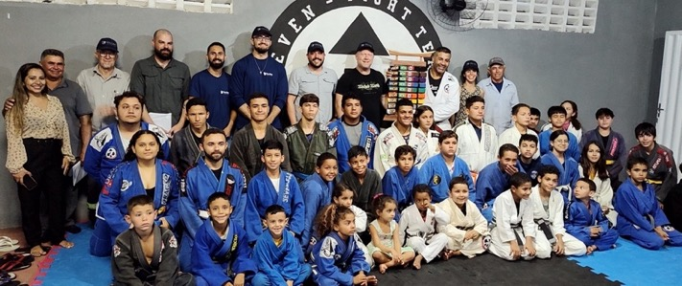
VALORE:
THE PERFECT TIME
Thiago Diniz – VP Exploration
M.Sc Economic Geology – Queens University. Exploration, development of fertilizer, base & precious metals,\in Brazil & Canada
Building an integrated precious metals company, focused on most prospective areas of Brazil
Pt /Pd Market: Structural Deficit
Assets in Brazil
The Right Team
After years of being undervalued, Pt & Pd experiencing breakout price growth.
However, lack of new supply leading to multi-year deficit of 500 – 700k oz.
100% owned Pedra Branca Asset - 2.2M Oz, Platinum, Palladium and Gold¹ .
Near surface, accessible orebodies with excellent regional infrastructure and exploration upside.
Actively pursuing acquisition and partnership strategy.
Part of Discovery Group ($1BN raised, $2.6BN M&A activity).
World Class team on the ground in Brazil.
Track record of geological resource expansion, exploration success and operational execution.
Strong community support.
Exceptional field team
Strong community support
1. Independent Technical Report – Mineral Resource Update on the Pedra Branca PGE Project, Ceará State, Brazil (Effective date: March 8, 2022)
4

Slide 5
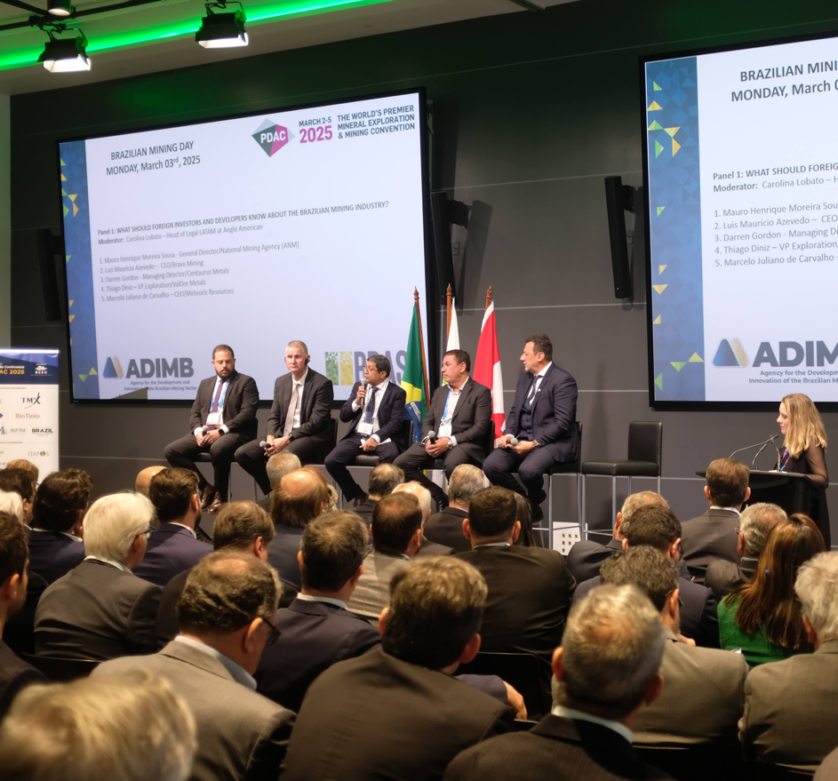



BRAZILIAN POWERHOUSE
Building a Multi-Generational Mining Success Story
A LEADER IN PRECIOUS METALS PRODUCTION
Top 10 gold producers globally, producing ~$3.8BN annually and growing to >$6BN by 2030¹.
BRAZIL IS INVESTING IN ITS MINING FUTURE
Stable regulatory frameworks support investment and streamline approvals.
STRONG PIPELINE OF DOMESTIC TECHNICAL AND OPERATIONAL TALENT
Brazil now graduates more mining engineers than both USA and Canada combined!²
T. Diniz (at left) as part of Brazilian Delegation at PDAC 2025 (Source: ADIMB)
Sources:
1. Grand View Research
2. MiHR
5

Slide 6
PRECIOUS METALS:
GOLD, PLATINUM AND PALLADIUM - RECORD PRICE GROWTH
ValOre’s strategy is to become an integrated precious metals producer, anchored by:
PLATINUM & PALLADIUM:
Platinum prices surged past ATH of $2,700 /oz (+20% in Jan) – closing ~$2,000/oz
Palladium passed $2000 / oz (+11% in Jan) – closing at ~$1,700/oz
GOLD:
A further 5 daily price records for Au, passing $5,000/oz – closing at ~$4,600 /oz
Au +130% yoy
Pt +161% yoy
Pd +87% yoy
1. https://matthey.com/products-and-markets/pgms-and-circularity/pgm-management
6

Slide 7
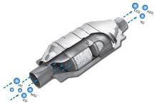


PLATINUM & PALLADIUM:
CONTINUED DEMAND AND LONG-TERM DEFICITS
Both Platinum and Palladium experiencing multi-year consecutive annual deficits
Above-ground stocks cut by 42%, leaving less than five months of coverage² .
PALLADIUM
1. AUTOMOTIVE DEMAND:
    Accounts for ~40% of total Pt demand and ~80% of all Pd and Rh demand
    Hybrid vehicles use 10 – 20% more PGEs per vehicle than ICE vehicles
    2025 New vehicle sales (Global): 55% ICE, 20% hybrids, 25% electric. Hybrid fastest growing
    Ford , Honda , Volkswagen & Porsche scale back EV plans, focus on more profitable hybrids
PLATINUM
2. JEWELRY DEMAND:
Global jewelry production accounts for ~ 70M oz of gold vs. ~2M oz of Platinum annually.
Switching 1% of the total current gold jewelry demand to Platinum would double the annual supply deficit for platinum of ~700k oz
3. INVESTMENT DEMAND:
Demand for physical platinum bar and coin in China has grown from nearly zero in 2019 to over 400k oz in 2025
1. Source: World Platinum Investment Council Data
2: Platinum Futures Near Record High
7

Slide 8

FEW PGE PROJECTS IN DEVELOPMENT GLOBALLY:
Table Notes:
- All information presented in this table has been derived exclusively from publicly available NI 43-101 technical reports and associated issuer disclosures for the referenced projects. Readers are cautioned to refer to and rely upon each project’s respective technical report for full details, assumptions, and qualifications: Waterberg Project; Luanga Project; Pedra Branca Project; Marathon Project; Stillwater West Project.
- Estimated future production, Mineral Resource/Mineral Reserve figures, grades, and metal equivalencies are presented as disclosed by the respective issuers, are based on project-specific methodologies and assumptions, and may not be directly comparable. The Company assumes no responsibility for the accuracy or completeness of third-party information.
¹4E: Palladium (Pd), Platinum (Pt), Gold (Au), Rhodium (Rh), as defined in each issuer’s technical disclosure.
²2PGE+Au: Palladium (Pd), Platinum (Pt), and Gold (Au), as defined in issuer’s technical disclosure.
³PdEq: Palladium equivalent grade or ounces calculated using issuer-specific assumptions disclosed in the relevant technical reports.
CONCENTRATED SUPPLY:
~90% of Worlds PGE reserves located in South Africa
Marathon Project,
Ontario, Canada
AGING MINES & INFRASTRUCTURE:
Since 2016, several major platinum operations closed / suspended
Stillwater West Project,
Montana, USA
Luanga Project,
Pará, Brazil
Pedra Branca Project,
Ceará, Brazil
Parks Reef Project,
Western Australia
LIMITED NEW SOURCES:
Only two major Greenfield PGE mines w/ near term production
Waterberg Project,
Limpopo, South Africa
Archaean cratons
Company | Location | Mineral Resource / Mineral Reserve | PGE Grades | Project Stage | Market Cap ($M CAD) - 18 Feb
Stillwater Critical Minerals Corp. (TSXV: PGE) | Stillwater West Project | 2.0 Moz Pd + 1.3 Moz Pt | 0.25 g/t Pd | Mineral Resource Estimate (2023) | $126M
 | Montana, USA | (254 Mt - Inferred Resource) | 0.15 g/t Pt
ValOre Metals Corp. (TSXV: VO) | Pedra Branca Project | 2.2 Moz 2PGE+Au² (63 Mt - Inferred Resource) | 1.08 g/t 2PGE+Au | Mineral Resource Estimate Update (2022) | $27M
 | Ceará, Brazil
Bravo Mining Corp. (TSXV: BRVO) | Luanga Project | 10.4 Moz PdEq³ (158 Mt - Measured & Indicated Resource) | 2.01 - 2.04 g/t PdEq | Preliminary Economic Assessment (2025) | $440M
 | Pará, Brazil | 5.0 Moz PdEq (58 Mt - Inferred Resource)
Platinum Group Metals Ltd. (TSX: PTM) | Waterberg Project (JV) | 23.4 Moz 4E¹ (246 Mt - Proven & Probable Reserves) | 2.96 g/t 4E | Definitive Feasibility Study (2024) | $389M
 | South Africa
Generation Mining Ltd. (TSX: GENM) | Marathon Project | 2.6 Moz Pd + 0.8 Moz Pt | 0.64 g/t Pd | Feasibility Study (2025) | $236M
 | Ontario, Canada | (128 Mt - Proven & Probable Reserves) | 0.20 g/t Pt
8

Slide 9
CLEAR 2026 ROUTE TO VALUE REALISATION
FOR VALORE’S PEDRA BRANCA
Project Advancement
Market Awareness
Bubble size – Measured + Indicated + Inferred resource (Moz PGE)
9

Slide 10
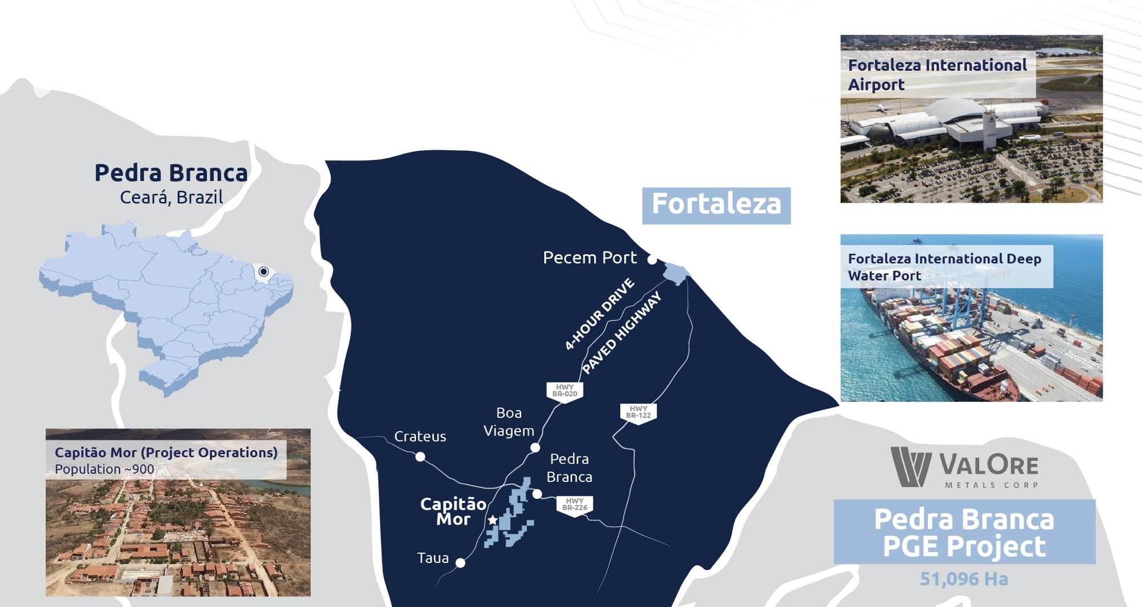
PEDRA BRANCA - PROJECT
EXCELLENT LOCATION & INFRASTRUCTURE
10

Slide 11
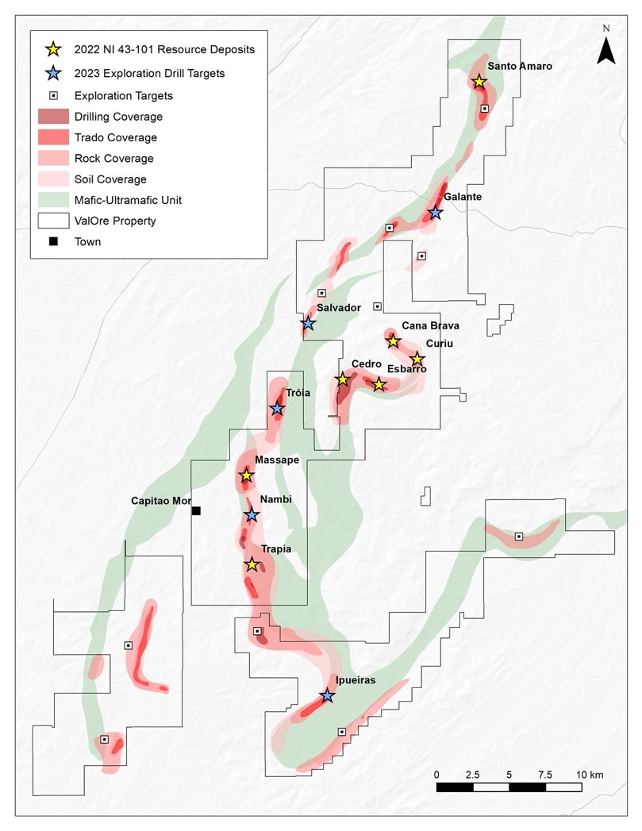
HIGH VALUE MINERALZATION
80km trend
7 Near Surface Resource Zones
+5 New Zones Drilled in 2023.
>1Moz 2PGE+Au
+Salvador Target
NI 43-101 Inferred Resource
Upside & Catalysts
2,198 koz 2PGE+Au in 63.3 Mt grading 1.08 g/t* released in 2022.
7 Resource Zones | > 40,000 m of drilling.
  4 Core Deposits | Esbarro, Curiu, Cedro & Cana Brava >1 Moz 2PGE+Au.
Large resource zones to south | Trapia & Massape >1 Moz 2PGE+Au.
5 new exploration zones drilled in 2023 (>6,000m) not included in the previous resource estimate.
New discovery – Salvador Target.
  Emerging North-South exploration trend.
  Ongoing flotation and leaching testwork in partnership with the University of Cape Town.
  PEA expected for 2026.
80km trend
*Independent Technical Report – Mineral Resource Update on the Pedra Branca PGE Project, Ceará State, Brazil (Effective date: March 8, 2022)
11

Slide 12
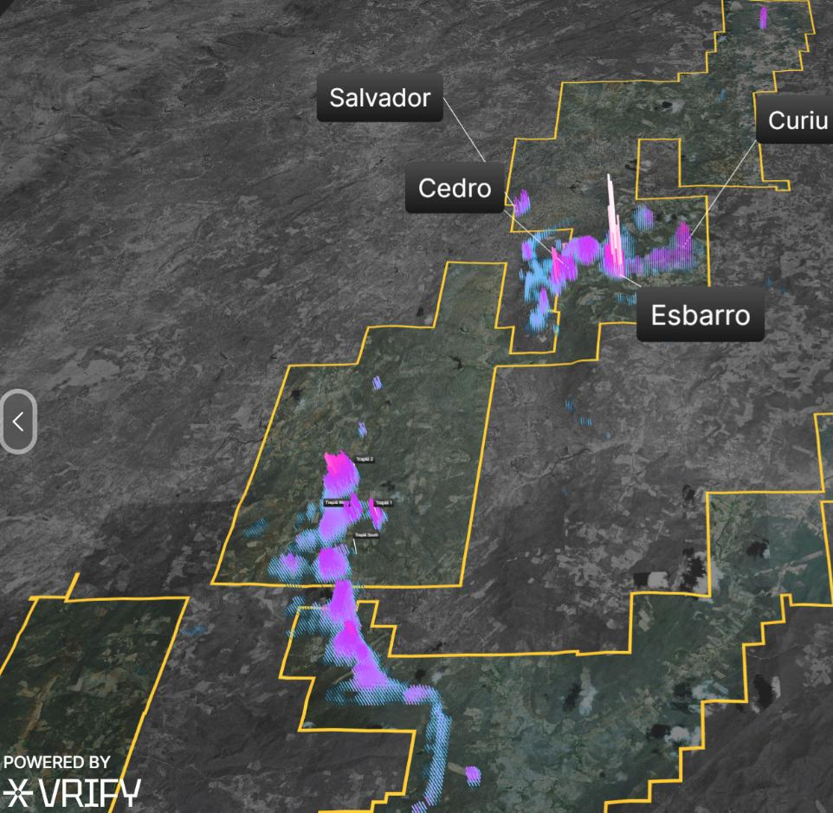
2026 EXPLORATION & DEVELOPMENT PLAN
  Focus on district-scale growth, project de-risking, and transition toward development
District-Scale Exploration
Development
Intensify use of the VRIFY technology to guide regional prospecting at the Pedra Branca property: follow up prospecting, surface geochem and Trado auger drilling
Focus on identifying and advancing new shallow in-situ PGE targets across the Pedra Branca district
Advance the Pitombeiras target (8 km mineralized trend) through geological mapping, rock and soil geochemistry and Trado® auger drilling
Advance metallurgical and engineering studies in support of development planning
Continue preliminary water and power supply studies
Relogging of historical drill core across core deposits (Curiu, Esbarro, Cedro) to refine geological and mineralization controls and mine planning assumptions
Targeting delivery of a PEA in Q4 2026
12

Slide 13
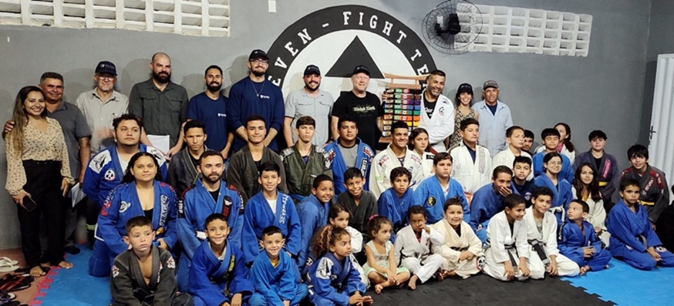
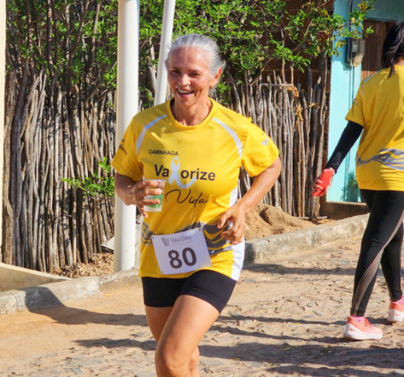
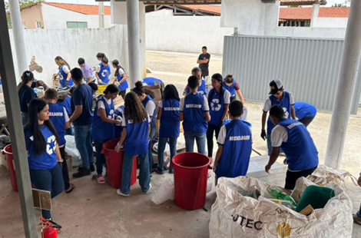
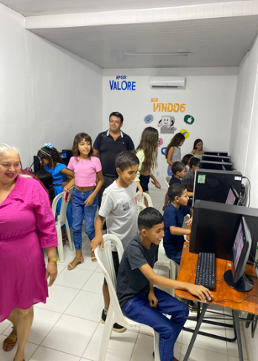
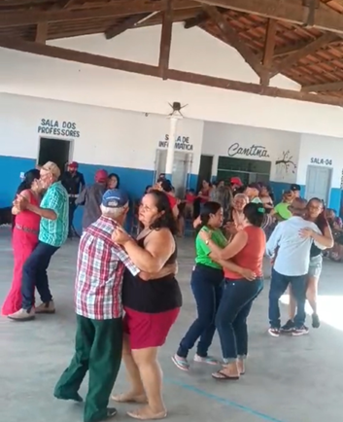
TREMENDOUS COMMUNITY SUPPORT
At ValOre, our objective is to contribute to the social and economic development of sustainable communities associated with our operation to ensure a legacy of improvement that will continue beyond the life cycle of the mine.
We support our local communities and their sustainability through measures such as development of capacity building programs, locally sourcing goods and services, sustainability through recycling, employing local people and support for local cultural initiatives
Dojo in Capitao Mor – over 100 kids and young adults practicing Jiu JItsu
Yellow September Walk (mental health)
Recycling at school
Computer Lab
Forro dance
13

Slide 14




BUILDING THE BRAZILIAN POWERHOUSE:
ACQUISITION STRATEGY
ACQUISITION TARGET TYPE / CHARACTERISTICS
ASSEMBLING RIGHT TEAM / EVALUATION
FINANCE FOR M&A AND GROWTH
PLAN EXECUTION
High-quality precious metals targets – Advanced stage gold projects in N.E. Brazil.
District-scale, exploration and development projects.
Significant prior investments with clear upside.
Leadership by an all-Brazilian exploration, permitting, development and operational team with proven ability.
Capacity to advance and add value to multiple projects in parallel.
Access to international capital markets via TSX and Bovespa listings supported by an experienced board of directors.
Ownership interest by strategic equity partners.
Rapidly advance pipeline projects through exploration drilling, permitting and updated engineering studies.
Leverage multi-disciplinary expertise and AI horsepower to maximize efficiency and expedite project(s) advancement.
14

Slide 15
VALORE GROWTH TRAJECTORY
Q4 2026
Pedra Branca PEA published
2020 - 2024
USD$10M invested in exploration 23,534 metres drilled by ValOre $30M invested, 30,000 m by historic operators
Targeted drilling: Doubled inferred resource from 1.1M → 2.2M oz
Q1 2026
Targeted M&A evaluation, focusing on potential for near-term production
Q1 2027
Pedra Branca licencing
and EIA
Q3 2026
Pedra Branca resource updates, including recently drilled targets
Q4 2025
Appointed engineering co. for PEA
Pedra Branca metallurgical testwork – demonstrate favourable economics
15

Slide 16
CORPORATE
STRUCTURE
High Insider Ownership &
Growing Institutional Support
$0.13
Share Price
$0.160
52W High
$0.050
52W Low
255M
Shares O/S
C$630k
Cash
C$27M
Market Cap
Options @ $0.12 expiring Oct 12, 2030: 20M
Warrants @ $0.10 expiring Oct 8 2027 : 29.5M (reduced from 50M)
Fully diluted: 304.4M shares
As of Feb 18, 2026
16

Slide 17
APPENDICES
17

Slide 18
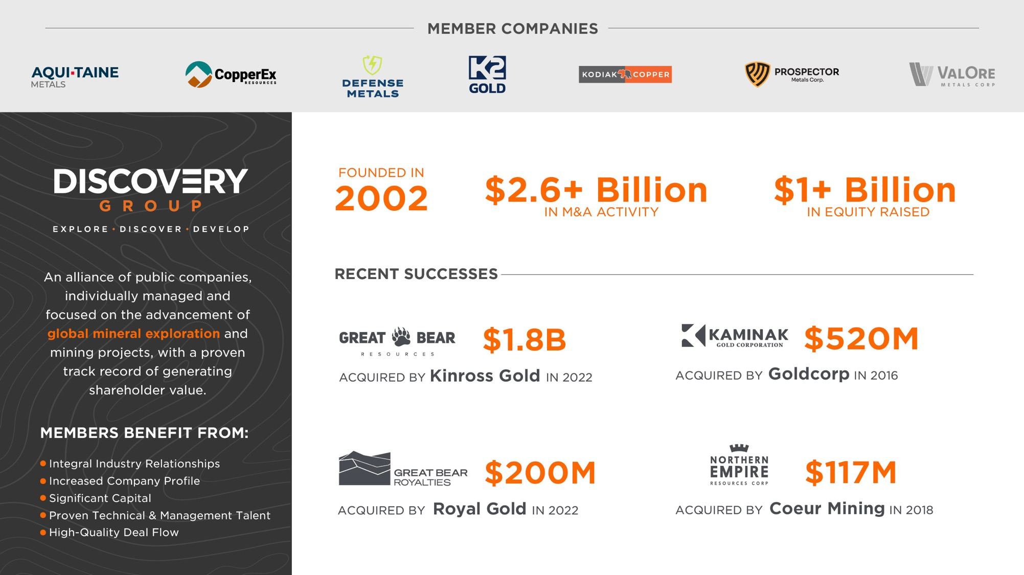

Slide 19
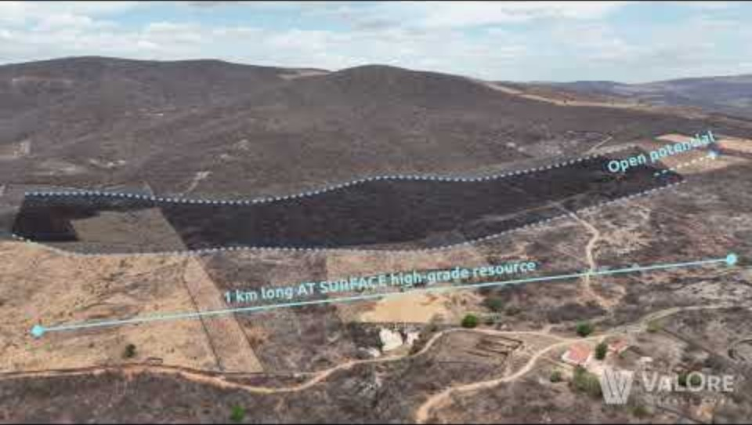
PEDRA BRANCA
19

Slide 20
PEDRA BRANCA – FLAGSHIP ASSET
2.2M OZ PLATINUM PALLADIUM GOLD RESOURCE
DEEP VALUE
CLEAR UPSIDE
CAD$10M invested in exploration; 23,534 metres drilled by ValOre; USD$30M invested, 30,000 m by previous operators.
2.2 Moz 2PGE+Au @ 1.08 g/t in 7 near surface inferred resource zones*.
51,096 hectares 100% owned in Ceara State, Brazil;
Excellent access and regional infrastructure.
Team that has delivered discovery, development & M&A success.
Strong community support.
Resource expansion:
Confirmed by 2023 drill program.
New discoveries:
80 km+ of prospective and underexplored PGE trend.
Development Potential:
Enhanced geological understanding.
Comprehensive metallurgical testwork underway.
*Independent Technical Report – Mineral Resource Update on the Pedra Branca PGE Project, Ceará State, Brazil (Effective date: March 8, 2022)
20

Slide 21
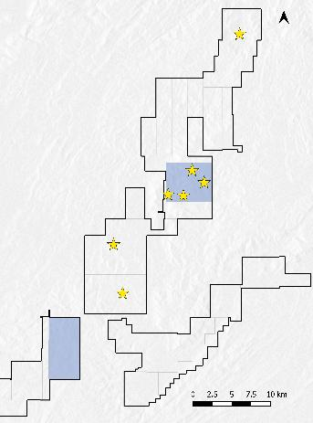
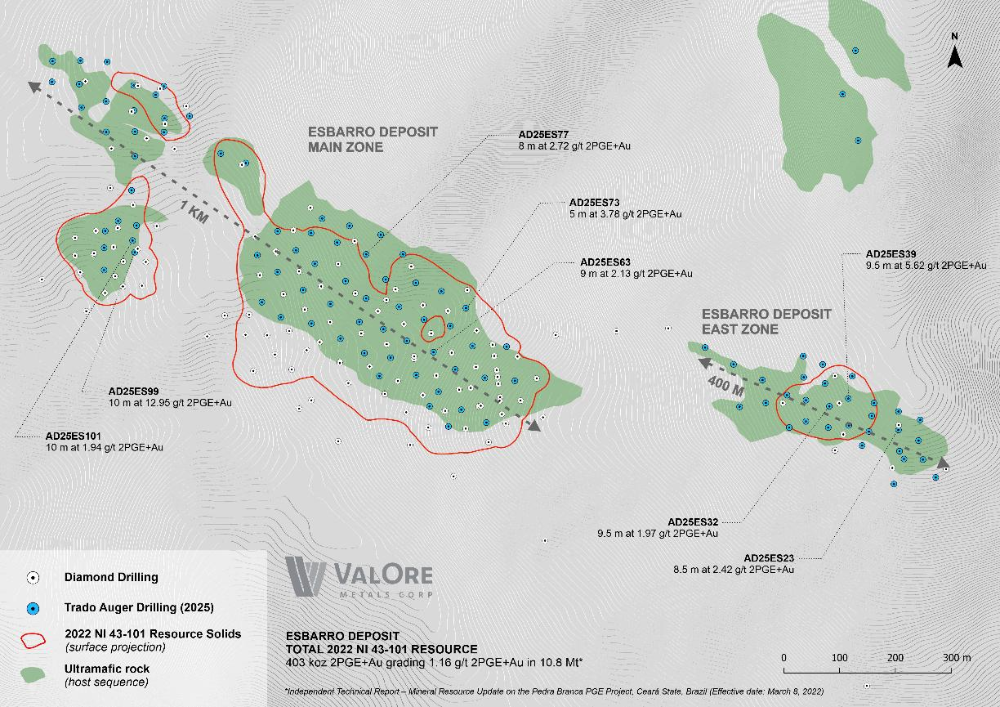
2025 EXPLORATION HIGHLIGHTS
Mining Concession
Application Phase
Shallow High-Grade Extension Confirmed at Esbarro + Major Regulatory Milestone Achieved
Core
Deposits
Exploration Success – Esbarro Extension
Pitombeiras
Completed 87-hole Trado® auger drilling campaign at Esbarro
Successfully extended mineralization beyond the current resource footprint into the Esbarro East Extension zone
  Multiple High-Grade PGE Intercepts (from surface)
Regulatory Milestones
        Brazilian National Mining Agency (ANM) approved Final Exploration Reports for Esbarro, Cedro, Curiu, and Cana Brava
        Claims have now advanced to the Mining Concession Application Phase
        Significant regulatory de-risking achieved, positioning Pedra Branca for future economic studies and permitting
21

Slide 22
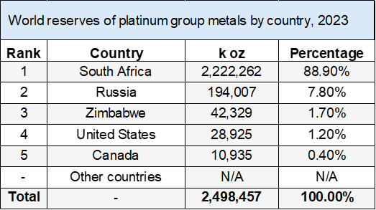
PLATINUM & PALLADIUM:
STRUCTURAL SUPPLY DEFICIT DRIVING MARKET OPPORTUNITY
HIGHLY CONCENTRATED SUPPLY:
PGE ore bodies tied to ancient mafic–ultramafic intrusions with a very specific set of magmatic and geochemical conditions needed to efficiently mobilise and concentrate PGEs
~90% of World’s PGE reserves are located in South Africa
AGING MINES & INFRASTRUCTURE:
Since 2016, several major platinum operations have been closed / suspended, incl. Bokoni in South Africa and multiple shafts at the Marikana, Rustenburg, Kroondal, Kloof and Beatrix complexes.
Contributing to structurally lower mine supply despite stable demand.
LIMITED NEW SOURCES:
Only two major Greenfield PGE mines in development:
            Ivanhoe’s Platreef mine, RSA (Phase 1 – 113k oz pa) | Tharisa’s Karo Mine, Zimbabwe (226k oz pa)
22

